Slide 1


Rocket NLP: Rapid End to End NLP Development and Analysis
Ryan Cornea, Thomas Ginter, Olga Patterson, Scott DuVall

Slide 2

NLP Pipeline – Consuming the Elephant
Assemble data and combine logic from various algorithms to attain a desired result
Continues Till Result
Algorithm1
Algorithm2
A1 Annotations
A1 Annotations
A2 Annotations

Slide 3
Goal
Rapid NLP Development
Scalable Architecture
Analysis code reuse – ours and others

Slide 4

UIMA
Reusable logic modules (Annotation Engine or AE)
Easily convert modules to UIMA Annotation Engine
Form organized pipelines of modules (Aggregate AE)
Common infrastructure
Serialization and Transport of Data
Metadata Storage and Indexing
Community support
Asynchronous Scale Out (UIMA-AS)
Notes:
Evaluated various platforms, including the possibility of writing our own, and eventually chose UIMA.
Benefits from our point of view

Slide 5
Data Structures
Common Analysis Structure (CAS)
Stores original text (SofA)
Stores metadata as Annotation Objects
Annotations
Features, like variables in java objects

Slide 6
The Data Contract
CAS stores both the SofA and the Type System
Type System “Object Oriented”
Type – class definition
Feature – member of the class “variable”
Feature Structure – Type instance
Single inheritance
Sub-type polymorphism
no methods or encapsulation
Language independent (C++ or Java) structure
Primitive types: integer, float, boolean, string
Complex types: arrays, lists, Annotation

Slide 7
UIMA Core
Collection Reader gets an empty CAS from UIMA, sets the text
A pipeline is defined as an Aggregate Analysis Engine
Each element of an Aggregate Analysis Engine an Analysis engine with an Annotator. The Annotator performs the business logic, i.e. Tokenizer, Lexical Parser, etc.
Pipeline
CAS
Collection
Reader
Tokenizer
Sentence Detection
Chunker
NER
Listener

Slide 8
More Core
Language Independent Serialization +
Generalized Framework = Descriptors
Type System
Analysis Engine
Aggregate Analysis Engine
Collection Reader

Slide 9
UIMA-AS
Service / Client Architecture
Third Party Broker for Queue Management
Deployment Descriptor
Top Aggregate
Descriptor
UIMA AS Service
Deployment
Descriptor
AE
JMX
Input Queue
Asynchronous
Messaging
Reply Queue
CAS
UIMA AS Client
Collection
Reader
UIMA AS Client
Listener
Notes:
UIMA-AS utilizes an open source JMS queueing application to coordinate messages between one or more services and one or more client applications.
Service and client can be co-located
Services across machines, same jvm, multiple jvms, etc. Multiple clients accessing one family of services including services that remotely access other deployed services.

Slide 10

Leo

Slide 11
Leo Framework Feature
Leo Aggregate Engine
Leo
Deployment
Descriptor
Token
Annotator
Sentence
Annotator
Chunker
Annotator
Regex
Annotator
Dictionary
Annotator
Leo Service
Deployment
Descriptor
Top Aggregate
Descriptor
UIMA AS Service
AE
JMX
Input Queue
Asynchronous
Messaging
Reply Queue
SubReader
UIMA AS Client
UIMA AS Client
Leo
SuperReader*
Listener(s)
Leo Client
*Can also use Standard UIMA CollectionReader

Slide 12
Leo Framework Feature
Programmatically Generate:
UIMA Descriptors
Parameter and Type information for AE
Aggregate AE for a Service
Deployment Configuration
Standard and Custom CollectionReaders
Standard and Custom Listeners
Launch Services and Clients in UIMA-AS

Slide 13
Leo Service Overview
Define Pipeline Programmatically
(Type System, Annotators)
Register with Analytics Module (optional)
Deploy
(Generates UIMA XML files, deploys to UIMA AS Broker)

Slide 14
Leo Client Overview
Define Client
(Broker URL and Service Name, Collection Reader, Listeners)
Run
(Standard UIMA AS send CAS and invoke Listeners on results)

Slide 15
Leo Readers
File
XMI
Simple Database
Batched Database
Knowtator
Siman
Third Party/Custom Readers

Slide 16
Leo Listeners
CSV
XMI
Database
Siman
Knowtator
Third Party Listeners

Slide 17
Leo Annotation Feature
Annotation Utilities
Find, compare, overlap, modify…
Annotator Functionality
Base structure for standard module implementation

Slide 18

Current Release
Documentation
http://department-of-veterans-affairs.github.io/Leo/index.html
Source Code
http://decipher.chpc.utah.edu/gitblit/summary/?r=bones/leo.git
Maven Dependency
<dependency>
<groupId>gov.va.vinci.leo</groupId>
<artifactId>leo-base</artifactId>
<packaging>pom</packaging>
<version>2015.10.1</version>
</dependency>

Slide 19
Leo’s Universe
Project AEs
- Applied project AEs
- Not-quite Enterprise AEs
Chex
- Validation
JAM
- Performance monitoring
Marian
- Enterprise Quality AEs
Sherlock
- Machine Learning Framework
Siman
- Simple Annotation Schema
Any UIMA AS AEs
Leo
- Framework
- Annotation
ChartReview
- Annotation and document classification
Any (non-AS) UIMA AEs
like cTAKES
UIMA AS
Notes:
Set of libraries that provides easy access to UIMA AS functionality.
BONES: ws annotator, regex, annotation pattern
DERMA: hist, window annotator
PROJECTS: smoking, bcc, cvad, etc
Marian
ALSO ADD other UIMA annotators (Leo can register automatically)

Slide 20
JMX Monitoring
JMX Monitoring provides the missing piece to UIMA AS:
Easy collection of performance metrics for running UIMA pipelines
Aggregation of statistics from a distributed system
Presentation of statistics in an easy to interpret format

Slide 21
Analytics Tool
Design Goals
Gather statistics from various UIMA AS services
Aggregate the data into meaningful numbers
Give a both a broad and detailed view of system performance
Easy to use
Persist analytics
Compare analytics over time [Future work]
Allocate new resources as bottlenecks occur. [Future work]

Slide 22
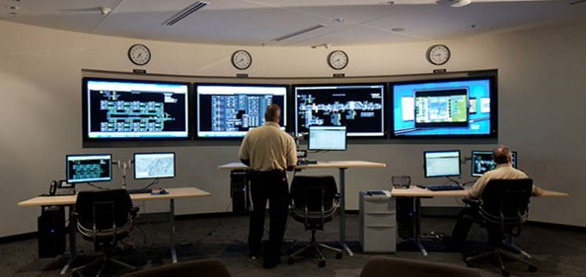
JAM

Slide 23
JAM
JMX: Port
UIMA AS
Server 1
JAM Server
Statistics:
Aggregate
Individual
Real Time Gathering
Can Gather Over a Port Range
Compare Over Time (Future)
Standard WAR (Tomcat, Jetty, JBOSS, etc.)
Web User Interface
Service 1
Performance Metrics
DB
UIMA AS
Server 2
JMX: Port 1
Service 1
JMX: Port 2
Service 2

Slide 24
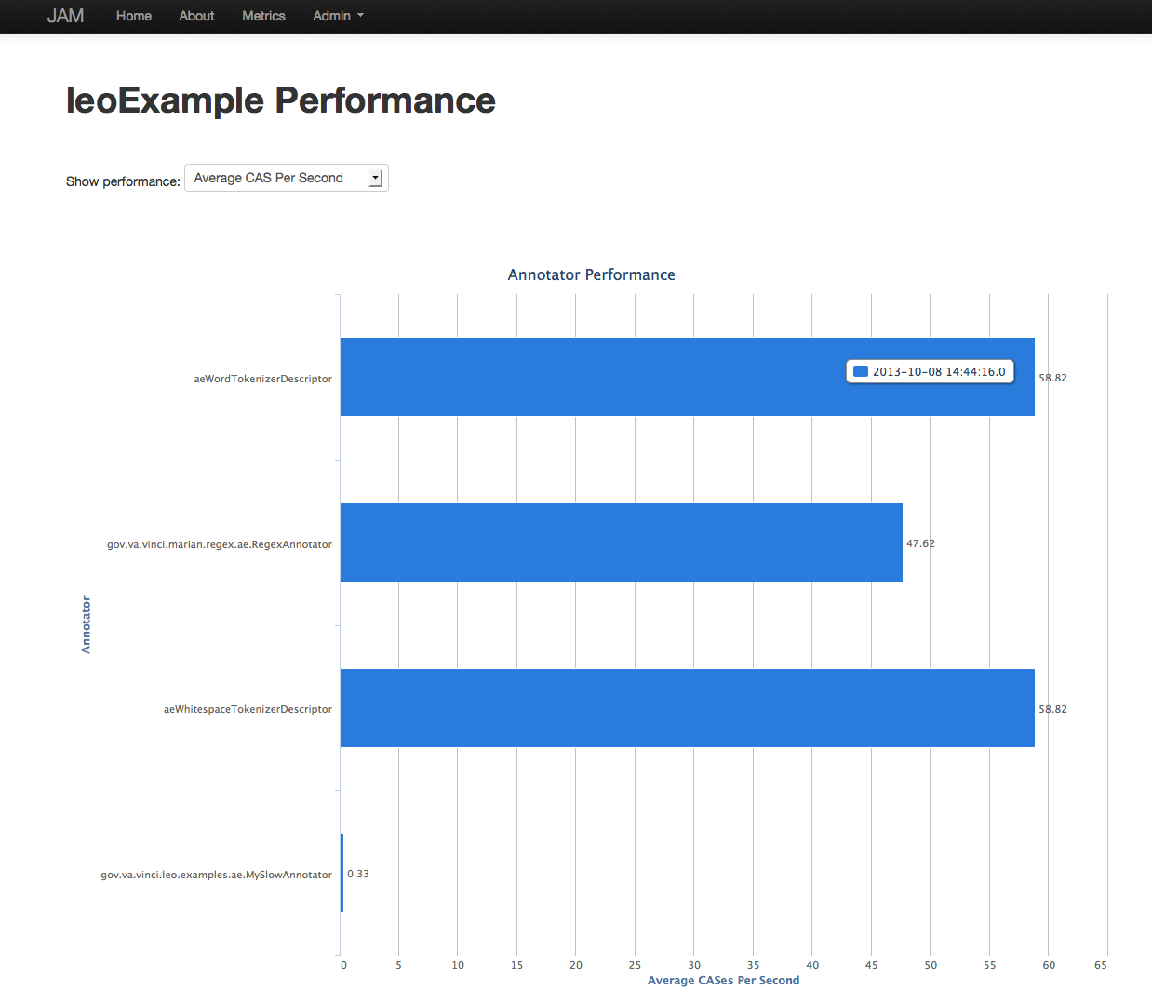
Service View

Slide 25
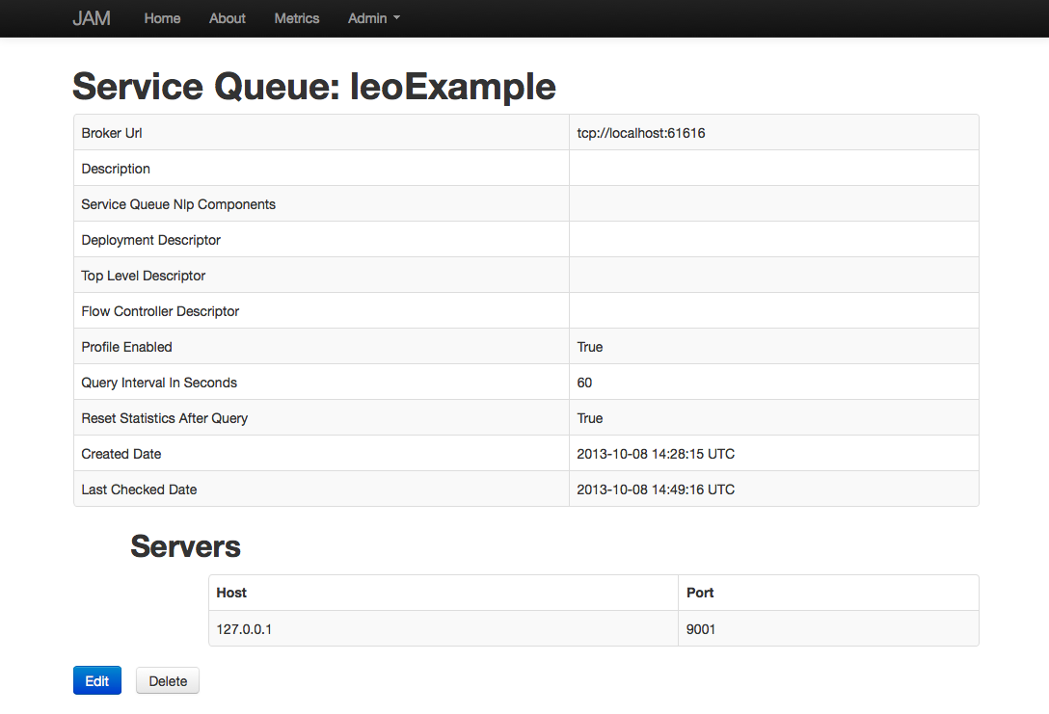
Service Details Screen

Slide 26
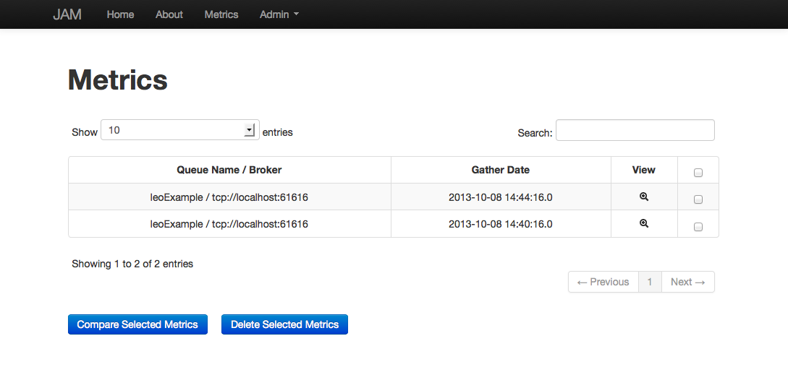
Metrics

Slide 27
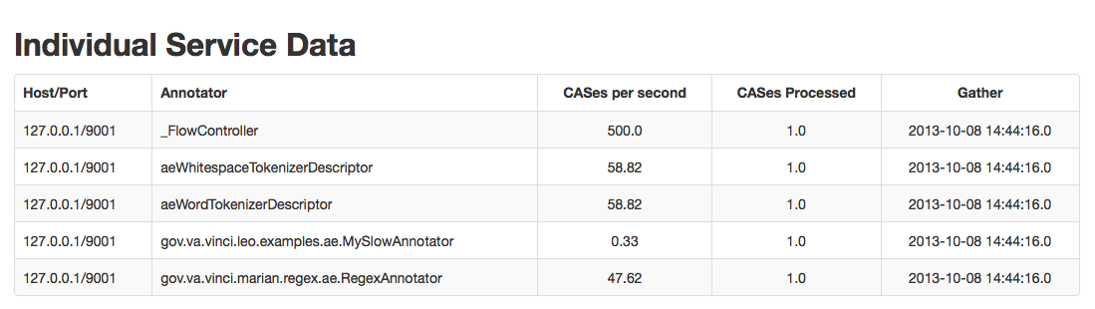
Service View Details

Slide 28
Chex Validation and Classification Made Easy

Slide 29
Chex
Chex is a web application that allows for annotators to validate information.
Information is stored in the SIMAN format.
Reporting on validation status is built in.
Reads from project specific databases, not one single unified database.
Supports all major databases
Validation information can be read from SIMAN and added into a UIMA pipeline.

Slide 30
Validation Tasks

Slide 31
Instance View

Slide 32
Document View

Slide 33
Review

Slide 34
Reports

Slide 35
Corpus Summary

Slide 36
Validation Summary

Slide 37

Sherlock

Slide 38
Machine Learning
Many different ML frameworks available
MALLET, R, Weka…
Every framework has a different
Data Model
API
Framework differences complicate reuse, flexibility and inhibit rapid development

Slide 39
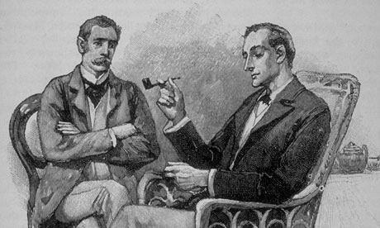
Sherlock
ML Framework Agnostic
Reusable modules
Feature Vectors
Prediction
Training
Easy Integration with UIMA-AS/Leo

Slide 40

Sherlock’s Tool Arsenal
SherlockTrainer
Train, Test, and Cross Validate
Requires VectorTranslator and List of FeatureVectors
PredictionMap
Maps input from human classified data to ML labels
Uses JSON formatted string to define mapping
SherlockVector
Stores a prediction string, keys, and values for a specific feature vector

Slide 41
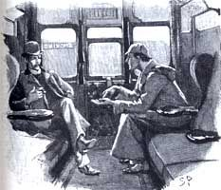
Sherlock In Action
Training Pipeline
MyFeatureVector extends BaseFeatureVectorAnnotator
MyLearningListener
extends
Learning Listener
SherlockTrainer
MALLET, R, Weka…
VectorTranslator*
*ML Framework Specific
Prediction Pipeline
MyFeatureVector extends BaseFeatureVectorAnnotator
LearningAnnotator

Slide 42
ChartReview

Slide 43
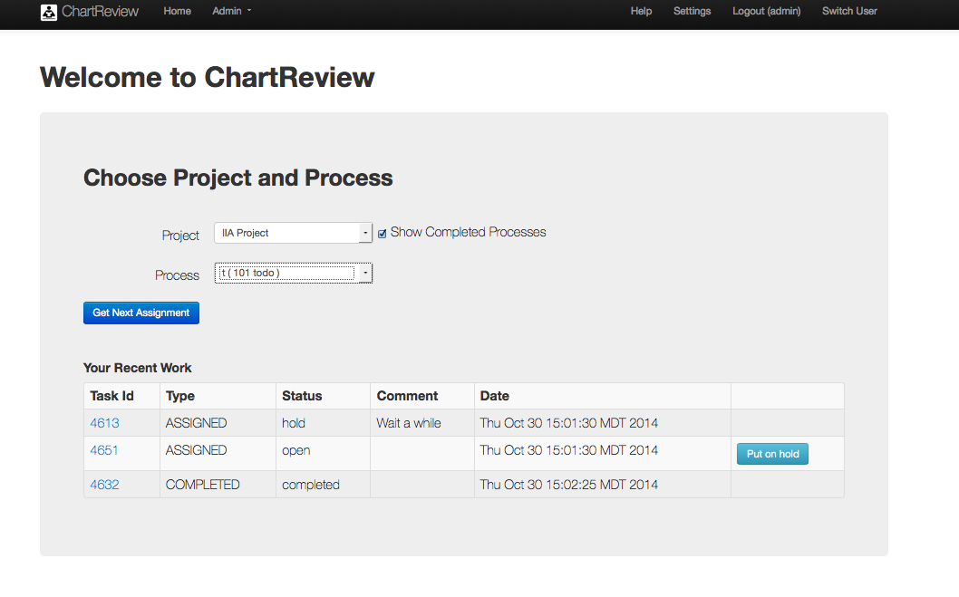
Pull not Push

Slide 44
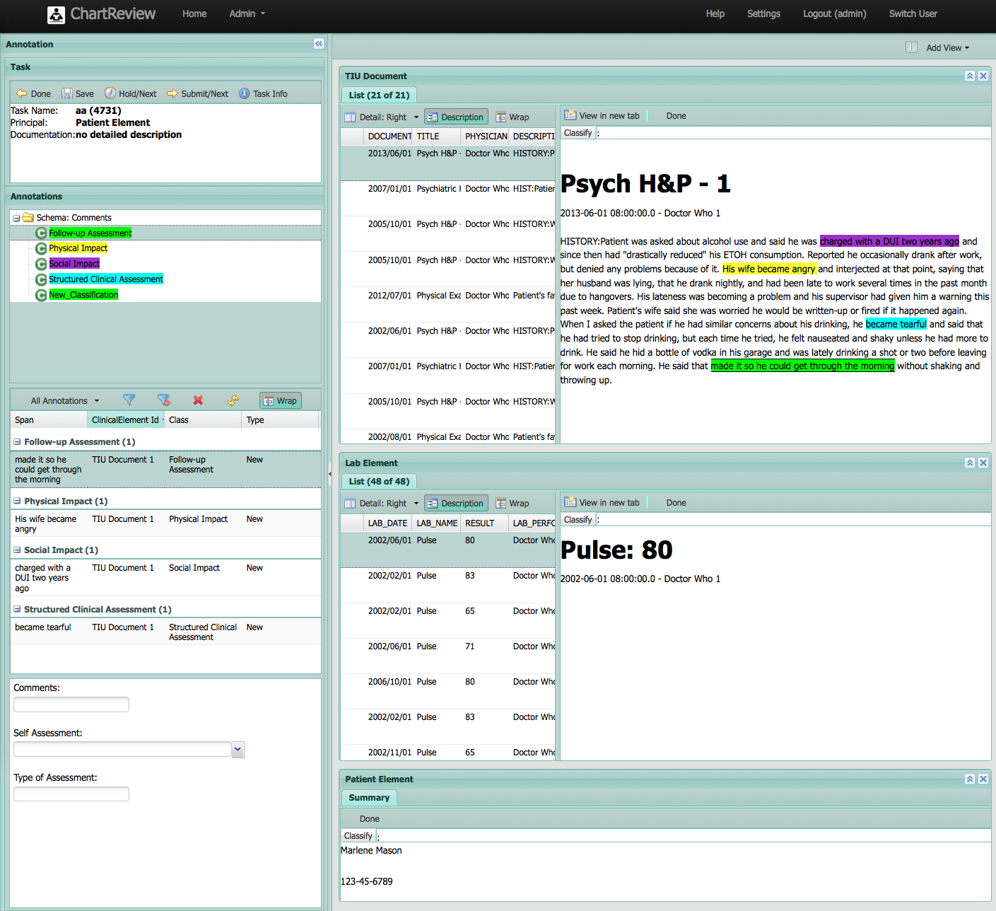
Patient Focused Annotation

Slide 45
Questions?

Slide 46
Scalability

Slide 47
Development Scalability
Common infrastructure
Input / Output
Serialization and Transport of Data
Metadata Storage and Indexing
Reusable logic modules
Logic from other platforms can be easily incorporated
Community support

Slide 48
Scalability of Processing
Scaling Up
Adding resources on the same server
More threads per process
More processes for the service
Scaling Out
Adding resources on multiple servers
UIMA-AS supports Both
ActiveMQ Broker
Asynchronous vs Synchronous pipelines

Slide 49
Synchronous Scaling
System
Demo Pipeline
1 document
every ~2 seconds
4 documents
In 2 seconds
2 documents
per second
Control

Slide 50
Asynchronous Scaling
System
Demo Pipeline
1 document
every 2 seconds
2 documents
In 2.5 seconds
1 document
In 1.25 seconds
Control

Slide 51
Demo Project

